Slide 1
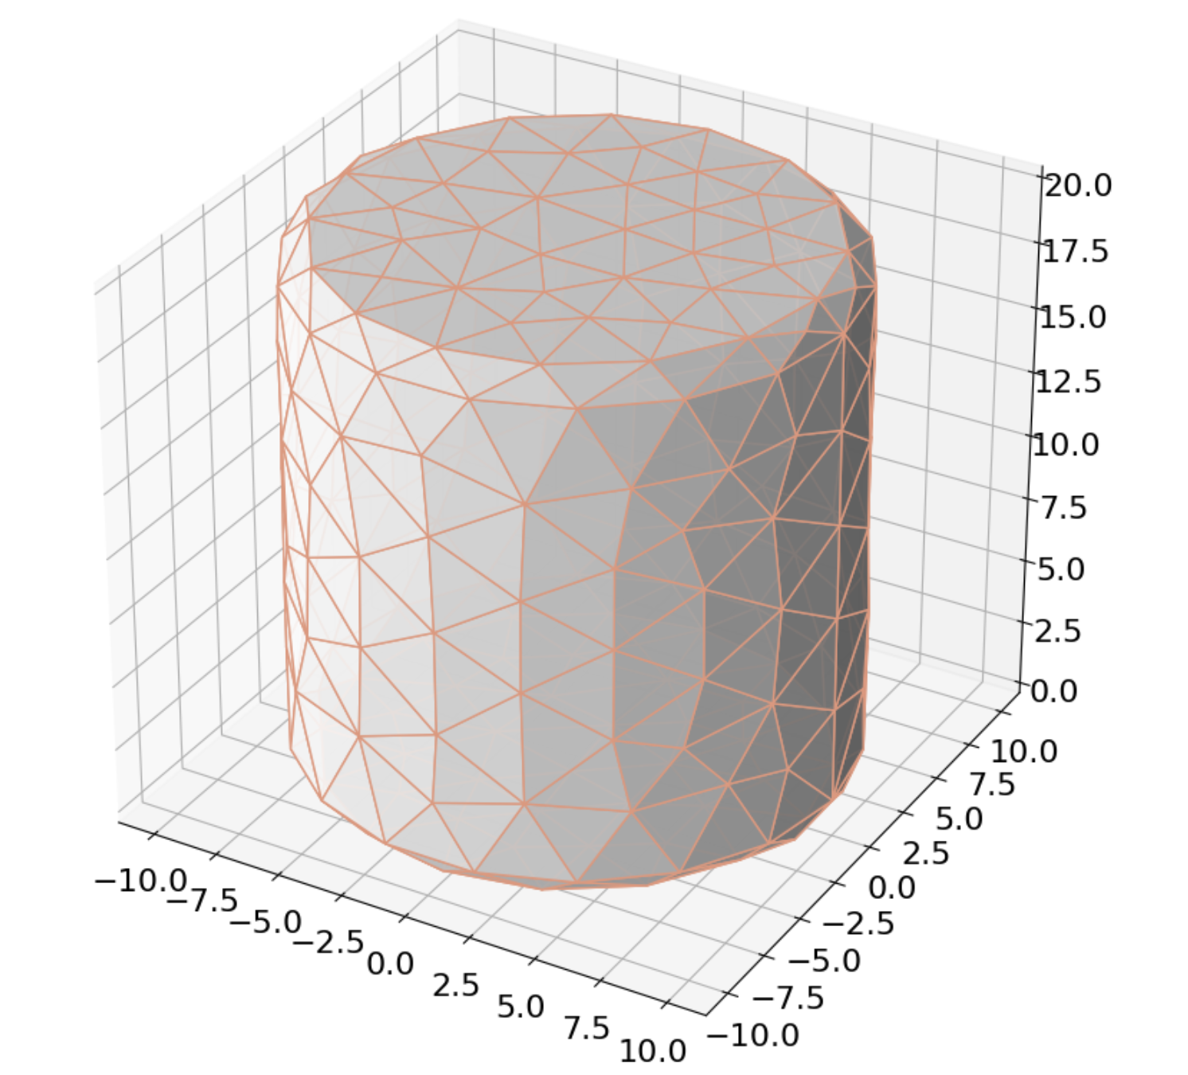
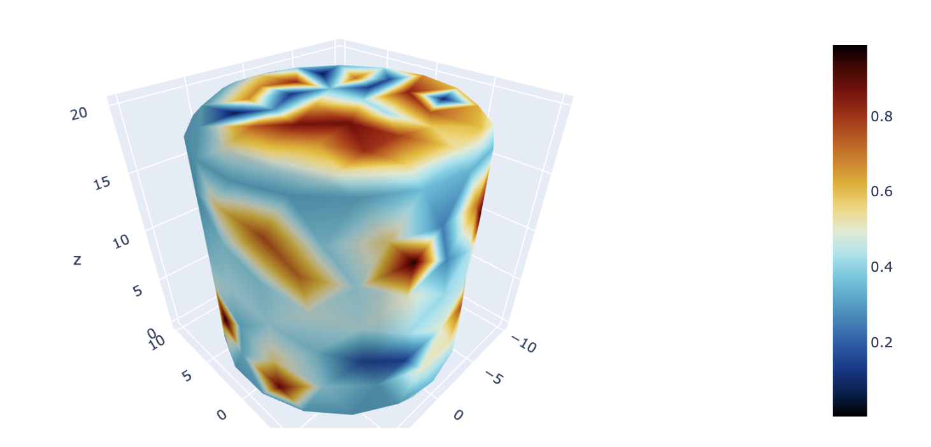
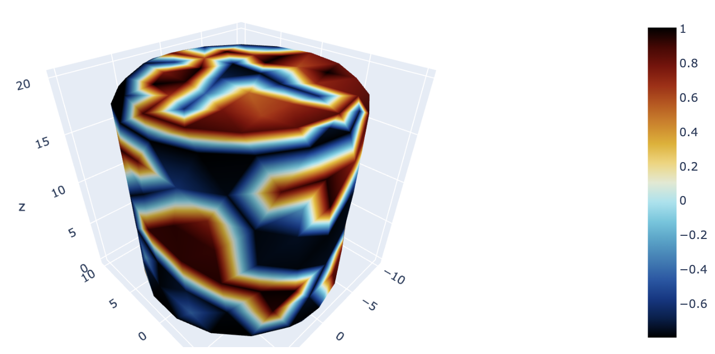
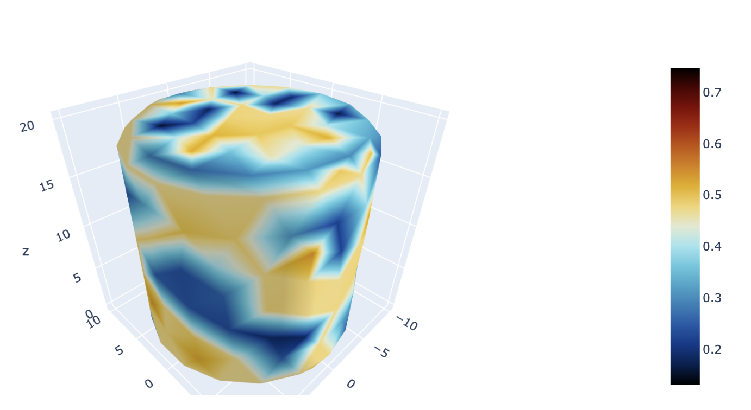
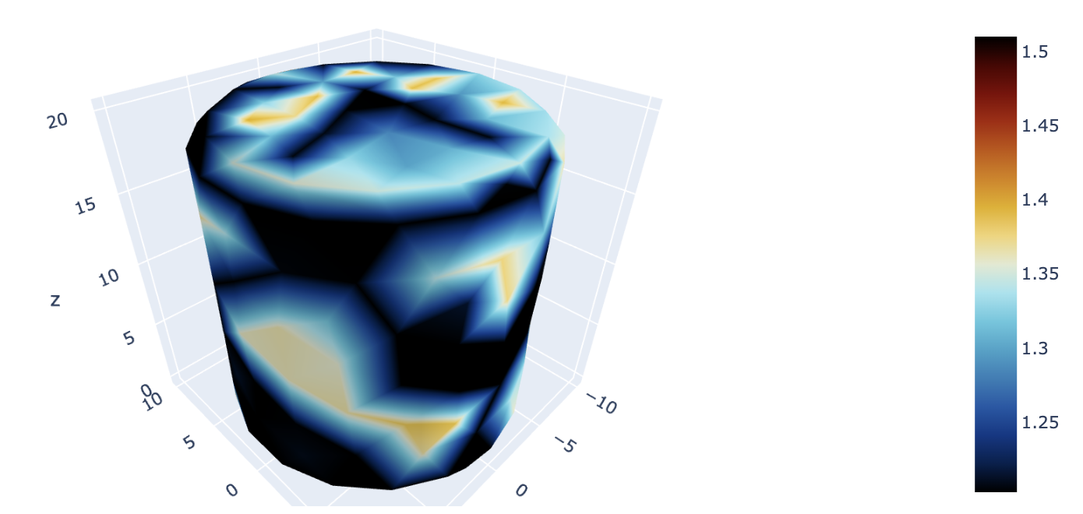
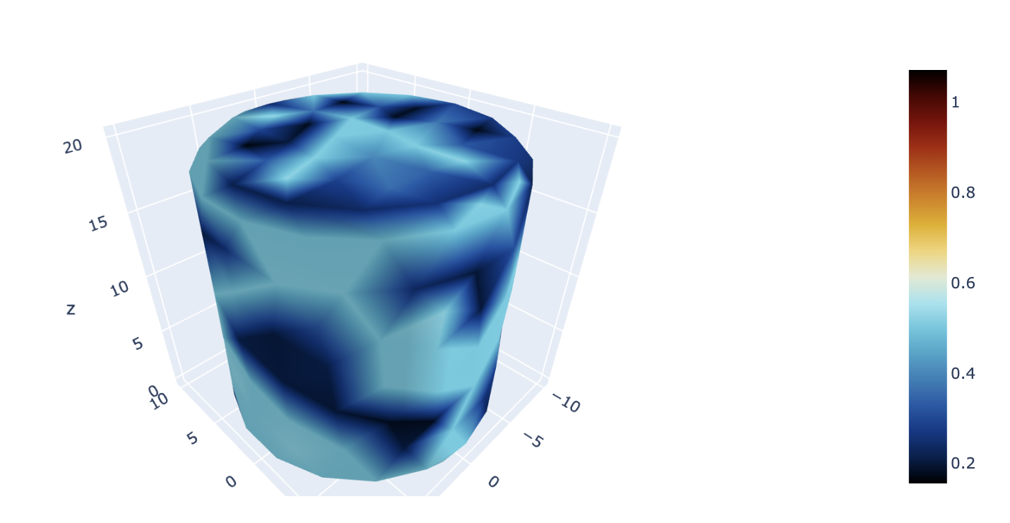
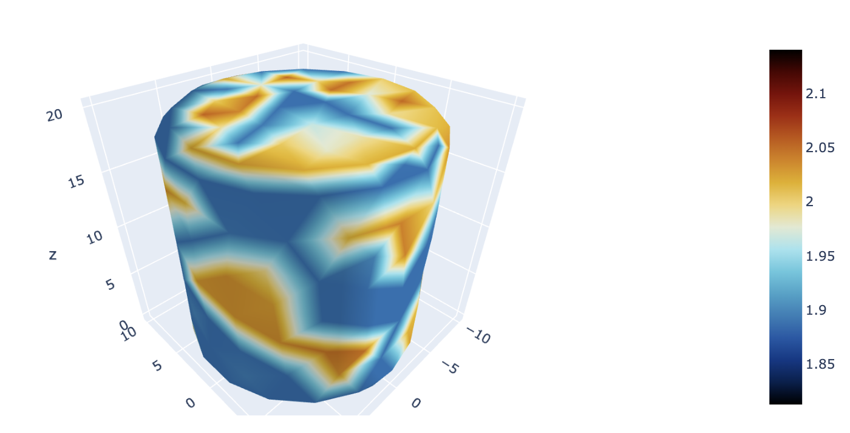
Cylinder
Turing pattern of u
Turing pattern of v
T = 0
T = 0
T = 1
T = 1
T = 2
T = 2

Slide 2
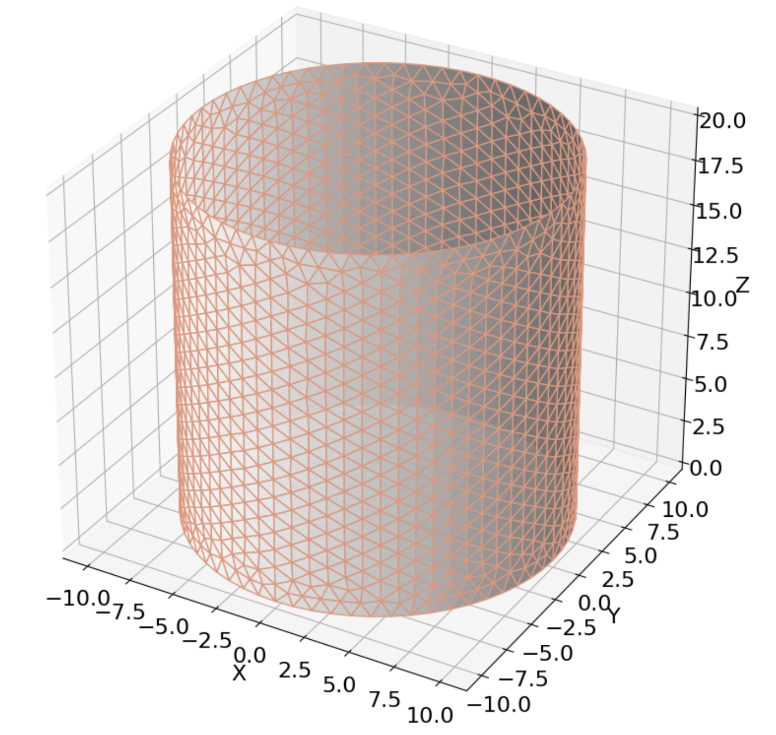
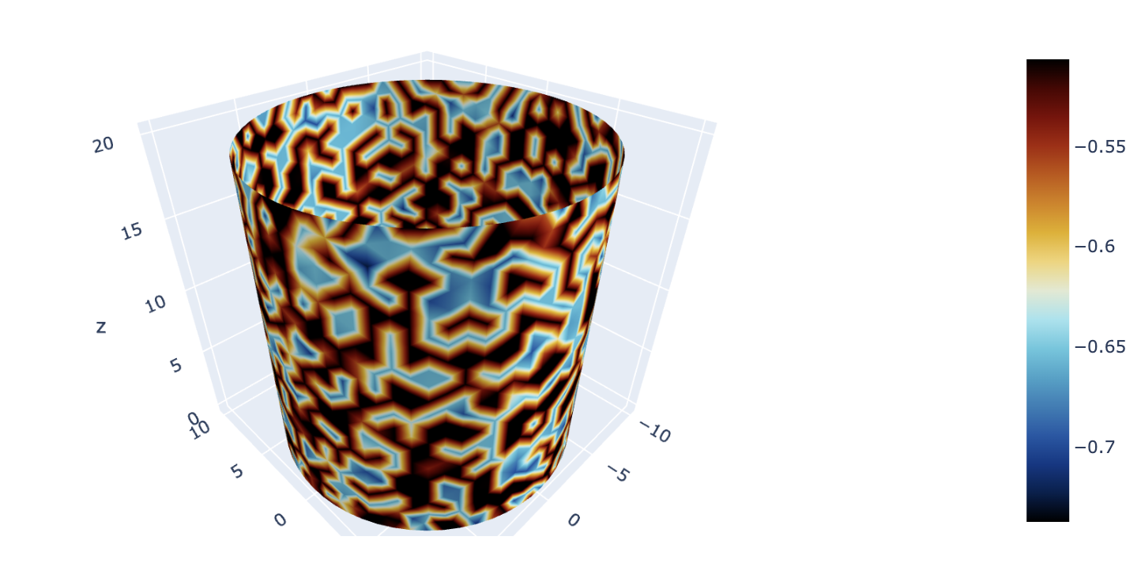
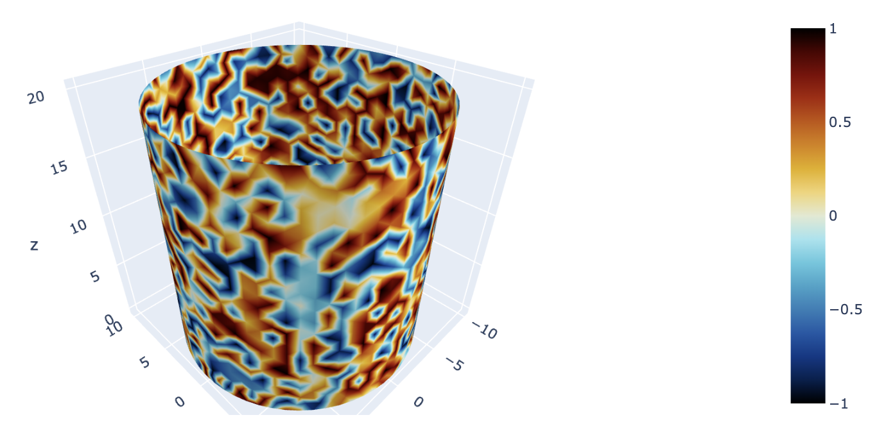
Turing pattern of u
Turing pattern of v
T = 0
T = 0
T > 0
Convergence Error: Nonlinear solve failed to converge after 0 nonlinear iterations. Reason: DIVERGED_FNORM_NAN

